Slide 1
CA - RA tool overview
Basic Terms of CA-RA tool and workflow
Aditya Rahatekar
Trainee
Tieto, ZST Technology Services and Modernization / ZSTEO DevOps & TECO
aditya.rahatekar@tieto.com

Slide 2
Table of contents
CA-Release Automation
Work flow, Objects, Infrastructure and UI
How we deploy an application

Slide 3
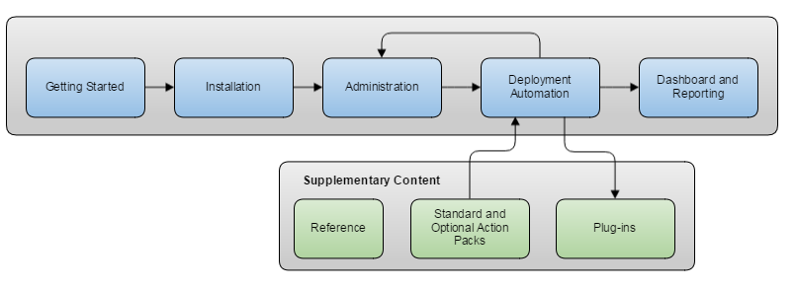
workflow

Slide 4
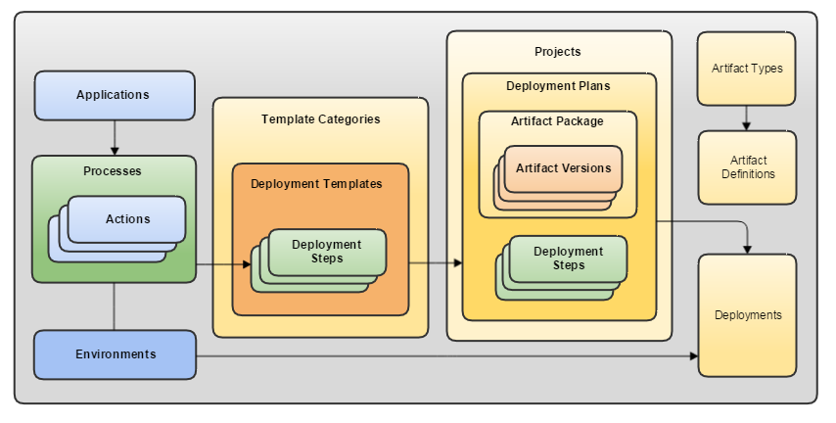
Objects model

Slide 5
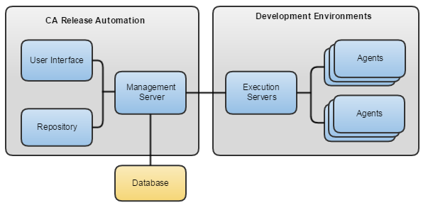
Infrastructure

Slide 6
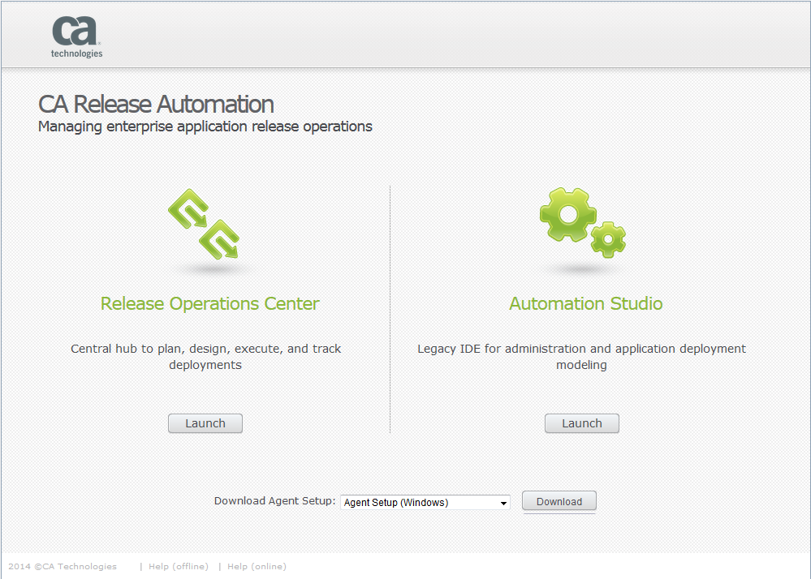
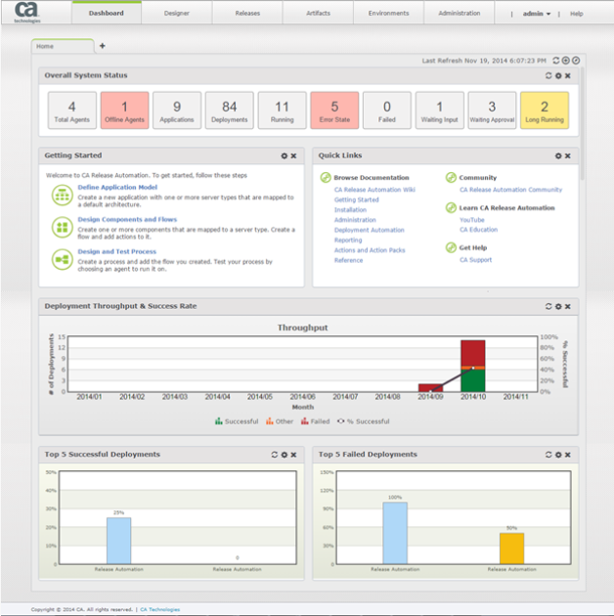
User Interface

Slide 7


Release
Automate
Inputs
files
steps
process
4

Slide 8
Aditya Rahatekar
Trainee
Tieto, ZST Technology Services and Modernization / ZSTEO DevOps & TECO
aditya.rahatekar@tieto.com

